Slide 1
Splunk Reports and Alerts
SIEM Day 2
Cybersecurity
SIEM Day 3
‹#›

Slide 2

Learning Objectives
By the end of today’s lesson, you will be able to:
1
Use the SPL commands stats and eval to create new fields in Splunk.
2
Schedule statistical reports in Splunk.
3
Determine baselines of normal activity in order to trigger alerts.
4
Design and schedule alerts to notify if an attack is occurring.

Slide 4

Today we will continue to learn about Splunk’s capabilities.
First, let’s review what was covered in the last lesson.

Slide 5

Splunk Review
Splunk provides software utilities that search, analyze, and monitor big data in a straightforward interface. We can add additional functionality to Splunk with apps and add-ons for specific vendors and industries.
Source: splunk.com
‹#›

Slide 6
Splunk Review
Splunk has three primary methods for accessing data:
Monitoring
Forwarding
Uploading
Splunk monitors logs from a system, device, or application to which it has direct access.
Install a program called a forwarder on the system from which logs are collected.
Manually upload logs directly into your Splunk repository.
Businesses commonly use this method to monitor their production environment.
Forwarders forward logs from a device into the Splunk system.
While monitoring
and forwarding are important to understand conceptually, we will primarily use the upload process for the rest of this lesson.

Slide 7
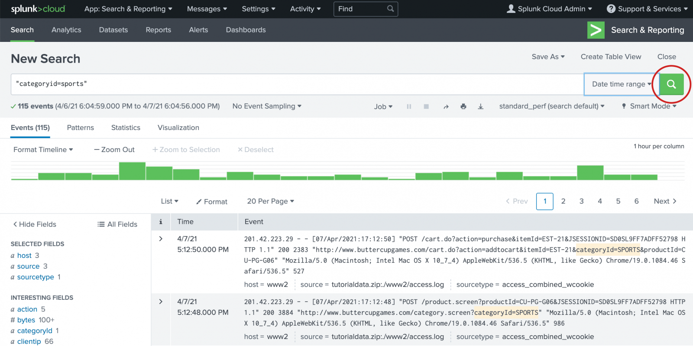
Splunk Review
Splunk’s primary feature is searching, which uses a coding language native to Splunk called Splunk Processing Language (SPL).
Splunk uses time-based search wherein each event or log has a time associated with it.

Slide 8

Splunk warm-up
In this activity, you will analyze logs from a Fortinet IPS system, determine the security issue, and provide mitigation strategies.
Breakout Rooms
X
The host is inviting you to join Breakout Room:
Breakout Room 1
Join
Later
15 minutes

Slide 9
‹#›

Slide 11

Splunk Statistics

Slide 12
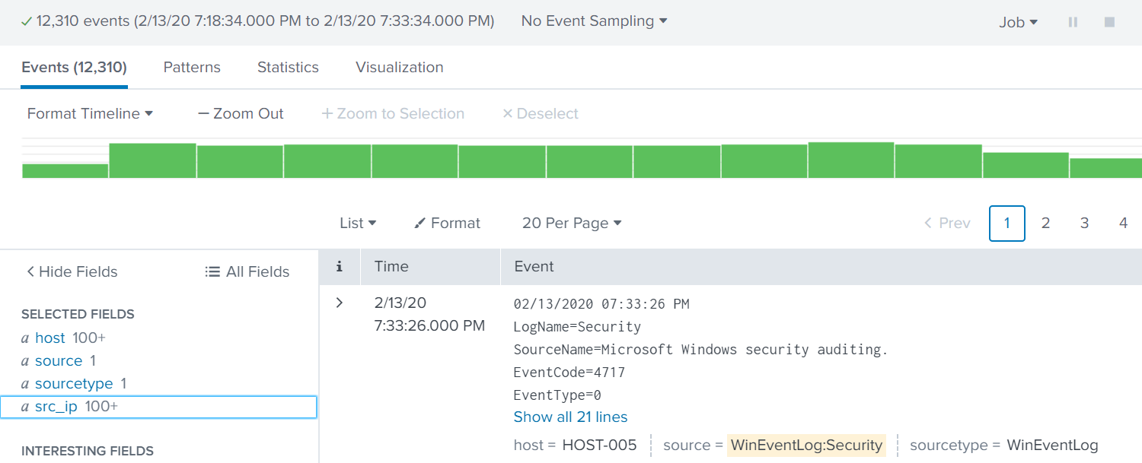
Splunk Statistics
Security professionals often need to present Splunk search results to non-technical audiences using simple formats.
For example:
If we need to illustrate the top 10 IP addresses from a DoS attack, this results page could be confusing to
a non-expert.

Slide 13
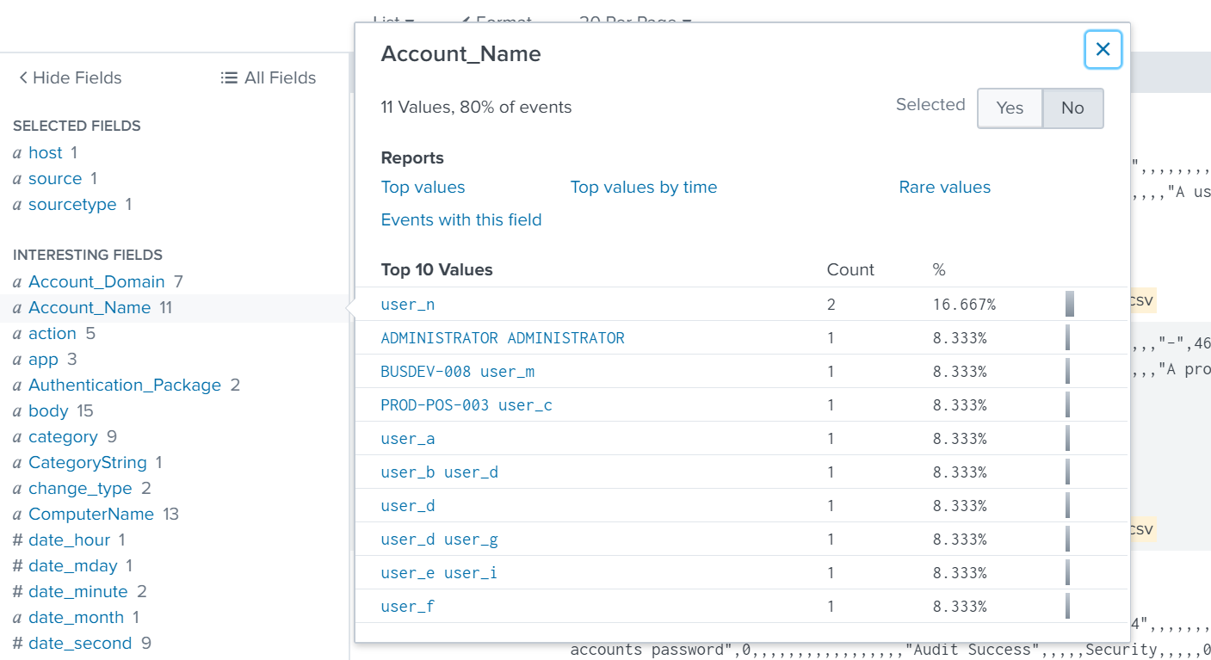

Splunk Statistics
Splunk uses the statistics feature to display specific data points from search results in an easy-to-read format.
The stats command is the most basic
Splunk command to create a statistics report.

Slide 14
We will use the stats command to create a simple statistical report of the top account names (Account_Name) being targeted in a brute-force attack.

Slide 15
Splunk statistics

Slide 16
Creating Fields with Eval
We can use Splunk to create new fields and add them to a statistical report.
For example:
Suppose we are analyzing logs for potential brute-force attempts.
Our logs have event codes (EventCode) that assign numerical codes to events.
EventCode 4740 indicates a user lockout.
Since user lockouts are a potential identifier of a brute-force attack, we can create a new field to identify events that contain this event code.
If the EventCode field has
a value of 4740, the field
value will be Potential Brute Force.
If the field does not have a value of 4740, the field value will be Not Brute Force.

Slide 17
The Eval Command
We can use the eval command to create fields.
1
The eval command calculates an expression (such as if then)
and places the resulting values into a search field.
2
If the search field doesn’t exist, it creates a new search field.
3
If the search field does exist, it overwrites the field with the new values.
source="statsreport.csv" | eval BruteForce = if('EventCode'="4740",
"Potential Brute Force", "Not Brute Force")

Slide 18
The Eval Command
We can use the eval command expressions, such as if, and place the resulting values into a search field.
Searches through all the results
from the statsreport.csv file.
source="statsreport.csv" | eval BruteForce =
if('EventCode'="4740", "Potential Brute Force", "Not Brute Force")

Slide 19
The Eval Command
We can use the eval command expressions, such as if, and place the resulting values into a search field.
Creates a new field
called BruteForce.
source="statsreport.csv" | eval BruteForce =
if('EventCode'="4740", "Potential Brute Force", "Not Brute Force")

Slide 20
The Eval Command
We can use the eval command expressions, such as if, and place the resulting values into a search field.
source="statsreport.csv" | eval BruteForce =
if('EventCode'="4740", "Potential Brute Force", "Not Brute Force")
States the following expression: “If the EventCode field has
a value of 4740.”

Slide 21
The Eval Command
We can use the eval command expressions, such as if, and place the resulting values into a search field.
source="statsreport.csv" | eval BruteForce =
if('EventCode'="4740", "Potential Brute Force", "Not Brute Force")
Continues the statement,
“If true, name this value Potential Brute Force.”

Slide 22
The Eval Command
We can use the eval command expressions, such as if, and place the resulting values into a search field.
source="statsreport.csv" | eval BruteForce =
if('EventCode'="4740", "Potential Brute Force", "Not Brute Force")
Continues the statement,
“If false, name this value
Not Brute Force.”

Slide 23
The Eval Command
We can use the eval command expressions, such as if, and place the resulting values into a search field.
Searches through all the results from the statsreport.csv file.
Creates a new field called BruteForce...
source="statsreport.csv" | eval BruteForce =
if('EventCode'="4740", "Potential Brute Force", "Not Brute Force")
States the following expression: “If the EventCode field has
a value of 4740.”
Continues the statement,
“If true, name this value
Potential Brute Force.”
Continues the statement,
“If false, name
this value
Not Brute Force.”

Slide 24
Splunk statistics
In this activity, you will create statistical reports to illustrate details about the DoS attack.
15 minutes

Slide 25
‹#›

Slide 26
‹#›

Slide 27

Splunk Reports

Slide 28

Splunk Reports
Statistical reports may need to be run at specific or recurring times.
For example:
If an organization is experiencing suspicious network attacks around 12am nightly, it would want to analyze its network traffic every night at that time.
With Splunk, we can create
and schedule custom reports
to automate this task.

Slide 29
Splunk Report Demonstration
In the following demonstration, we will create and schedule a report using the continued scenario of monitoring brute-force attacks:
1
We were notified that the most recent brute-force attacks happened around 12am.
2
Therefore, we will run a report at 1am each night to view activity for the past several hours.
3
We’ll also automate an email linking to the report after it runs.

Slide 30
Creating and scheduling reports

Slide 31
Splunk reports
In this activity, you will schedule a statistical report for OMP management so they can review the current state of the attacks
against a server.
15 minutes

Slide 32
‹#›

Slide 33
‹#›

Slide 35

Splunk Alerts

Slide 36
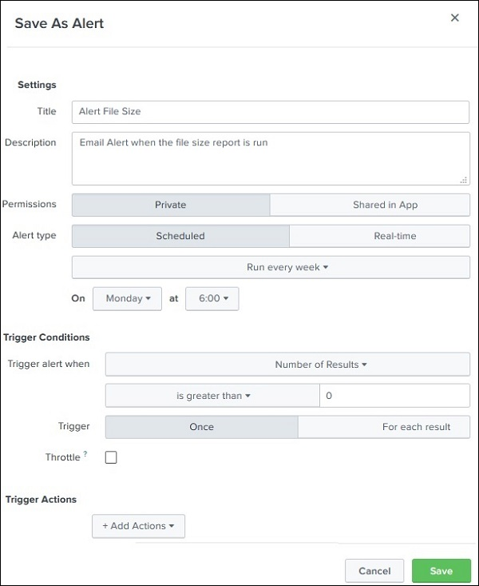
Splunk Alerts
So far we have covered how
Splunk statistics and reports help information security professionals identify potential security issues.
This process can be further improved through the use of alerts.
Splunk alerts are designed to automatically notify one or more individuals when a specific condition, known as a trigger condition, is met.
Splunk alerts are automatic. Once
they are created, Splunk’s software checks the trigger condition.

Slide 37
Splunk Alerts
A Splunk user selects a trigger condition based on the security event they are trying to monitor. Trigger conditions contain the following:
01
02
03
Search/Report Results indicate which criteria to check.
Time Parameters indicate the time period to check.
Schedule determines
the frequency with which these criteria are checked.
For example:
300 logins have
been attempted.
For example:
Within last
24 hours.
For example:
Every night
at 12am.

Slide 38
Splunk Alerts
When the condition is met, a trigger action is executed to alert the Splunk user.
For example:
"Send an email to soc_manager@acme.com."
In summary, the complete alert would be:
Every day at 12am, check if at least 300 login attempts have occurred within the last 24 hours. If this condition is met,
send an email to soc_manager@acme.com.

Slide 39

Baselining

Slide 40
Designing Strong Alerts
The key to designing strong alerts is to avoid false positives and false negatives.
 | False Positive | False Negative
What Occurred | Regular login activity | Brute-force attack
Alerts | Yes | No
Outcome | Alerts went off, but security professionals identified a non-issue. | No alerts went off, a brute-force attack occurred, and several accounts were breached.

Slide 41
False Positives
False positives occur when conditions are met and an alert is triggered, but the security situation did not actually occur.
1
For example, an alert is created to detect suspicious login activity on our Linux server.
2
The chosen criteria checks activity every hour and creates an alert when 10 login attempts occur within an hour.
3
Several alerts were triggered per these conditions, but further research determined that the alerts were set off by normal user activity.
4
The SOC realizes that 10 login attempts within an hour is not suspicious.

Slide 42
False Negatives
False negatives occur when the condition is met and an alert is not triggered, meaning the security situation occurred undetected.
1
For example, an alert is created to detect suspicious login activity on our Linux server.
2
The chosen criteria checks activity every hour and creates an alert when 500 login attempts occur within an hour.
3
Suspicious login activity did occur on the server when an attacker tried to brute force the Linux server with 400 attempts, but no alerts were triggered.

Slide 43
Security professionals can avoid these false results by using baselines to design their alerts.

Slide 44
Baselining is a method of looking at historical data to determine what should be considered normal activity.

Slide 45
Baselining

Slide 46
Setting a Baseline Threshold
Baselining looks at historical data to determine typical activity, which is known as a threshold. When the threshold is exceeded, an alert is triggered.
Setting the threshold too
high risks missing an alert.
Setting the threshold too low
creates too many false positives.

Slide 47

Alert fatigue occurs when security professionals receive so many alerts that they cannot adequately respond to each one.
Even when an organization builds good alerts and one gets triggered, security professionals will need to research and respond to it.
If an organization’s system triggers too many alerts, even if they are good alerts, security professionals will often miss issues as they get lost in the noise.

Slide 48
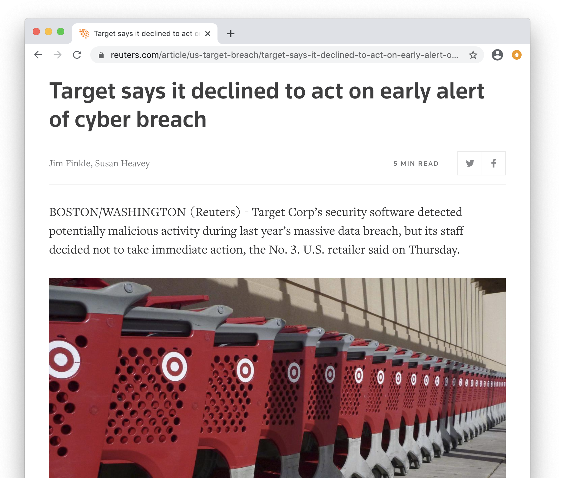
Alert Fatigue
Alert fatigue can have a major impact on organizations:
In 2014, a breach at Target
cost the company $252 million and led to the resignation of
its CIO and CEO.
One of the company’s security products detected the breach, but due to the high quantity
of alerts and the frequency
of false alerts, Target’s IT security team ignored it.
‹#›

Slide 49

Alert Fatigue
To prevent alert fatigue:
Limit the quantity of your alerts
to a manageable level for your organization.
Provide indicators of severity in the alerts so that they can be prioritized, such as critical vs. low-priority alerts.

Slide 50
Baselining
In this activity, you will review logs and create a baseline of typical
hourly login counts.
15 minutes

Slide 51
‹#›

Slide 52
‹#›

Slide 53
Creating and Scheduling Alerts

Slide 54
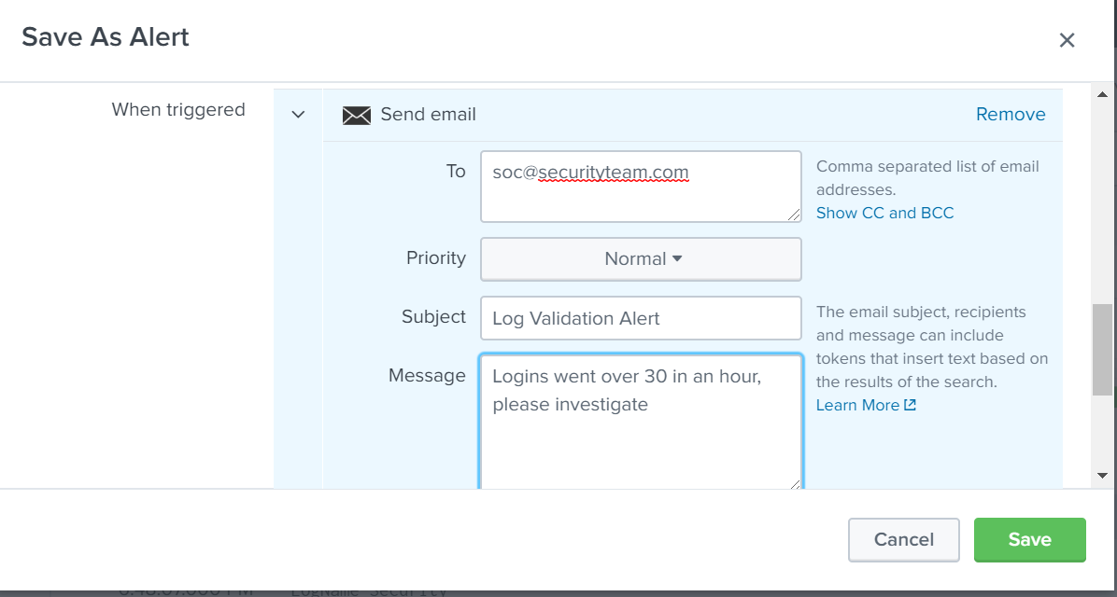
Creating and Scheduling Alerts
Now that we can determine accurate baselines, we can continue with our scenario and design the alerts.
We will design
an alert to trigger when 30 login attempts occur
in an hour.
We will run this alert to check the count every hour.
Once the alert
is triggered, an email will be sent.

Slide 55
Creating and scheduling alerts

Slide 56
Creating and scheduling alerts
In this activity, you will design and schedule an alert to notify your team if a brute-force attack is occurring.
Breakout Rooms
X
The host is inviting you to join Breakout Room:
Breakout Room 1
Join
Later
15 minutes

Slide 57
‹#›

Slide 58
‹#›

